Slide 1
ComColor GD Ink Flow Mechanism
RISO KAGAKU CORPORATION

Slide 2
Ink circulation Model (1)
Air Pump
Negative
Pressure
Pressure

Slide 3
Ink circulation Model (2)
Air Pump
Negative
Pressure
Pressure

Slide 4
Ink circulation Model (3)
Air Pump
Negative
Pressure
Pressure
Ink Pump

Slide 5
Ink circulation Model (4)
Air Pump
Negative-pressure: 10
Pressure: 9
Pressure: 10
Print Head
Ink Pump

Slide 6



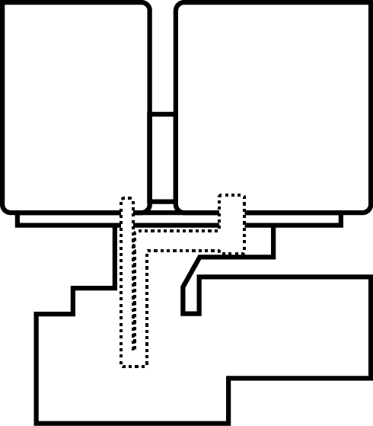
Pressure Control (1)
Pressure gauge
(Pressure)
Ink supply valve
Air Filter
Ink cartridge
Pressurization
Common air chamber
Pressure ink
Tank air valve
Ink Bus
Air Pump
Print Head
Flow rate
Control valve
Pressure gauge
(Negative pressure)
Negative pressure
Common air chamber
Negative Pressure
Ink tank air valve
Negative pressure ink tank
Negative
Pressure
Target Pressure
Pressure ink tank
Target
Negative Pressure
Pressure
Overflow Pan
Ink Pump

Slide 7

Pressure Control (2)
Pressure gauge
(Pressure)
Ink supply valve
Air Filter
Ink cartridge
Pressurization
Common air chamber
Pressure ink
Tank air valve
Ink Bus
Air Pump
pressure
control valve
Print Head
Flow rate
Control valve
Pressure gauge
(Negative pressure)
Negative pressure
Common air chamber
Negative Pressure
Ink tank air valve
Negative pressure ink tank
Excess
Pressure
Negative
Pressure
+9
Negative pressure
control valve
Pressure ink tank
-10
Excess
Negative Pressure
Pressure
Overflow Pan
Ink Pump

Slide 8
Ink circulation Mechanisms
Pressure gauge
(Pressure)
Ink supply valve
Air Filter
Ink cartridge
Pressurization
Common air chamber
Pressure ink
Tank air valve
Ink Bus
Air Pump
pressure
control valve
Print Head
Flow rate
Control valve
Pressure gauge
(Negative pressure)
Negative pressure
Common air chamber
Negative Pressure
Ink tank air valve
Negative
Pressure
Excess
Pressure
+9
Negative pressure
control valve
Ink level detection sensor
-10
Excess
Negative Pressure
Pressure
Ink level detection sensor
Overflow Pan
Ink Pump

Slide 9
Cleaning Mechanisms
Pressure gauge
(Pressure)
Ink supply valve
Air Filter
Ink cartridge
Pressurization
Common air chamber
Pressure ink
Tank air valve
Ink Bus
Air Pump
pressure
control valve
Print Head
Flow rate
Control valve
Pressure gauge
(Negative pressure)
Negative pressure
Common air chamber
Negative Pressure
Ink tank air valve
Negative pressure
control valve
Overflow Pan
Ink Pump

Slide 10
ComColor FW Ink Flow Mechanism
RISO KAGAKU CORPORATION

Slide 11
Ink Supply Mechanisms
Ink supply valve
Air filter
Ink cartridge
Pressurization
Common air chamber
Pressure ink
Tank air valve
Condition of
Ink supply operation:
Ink level detection sensor
(Pressure ink tank)>OFF
Ink level detection sensor
(Negative pressure ink tank)>OFF
Condition of
Ink Circulation pump operation:
Ink level detection sensor
(Pressure ink tank)>OFF
Ink level detection sensor
(Negative pressure ink tank)> ON
Negative pressure
Common air chamber
Negative Pressure
Ink tank air valve
Pressure & Negative pressure Ink tank
Float
Float
Ink level detection sensor
Ink level detection sensor
Pressure ink tank
Negative pressure ink tank
Ink filter
Ink Circulation pump
Overflow pan

Slide 12
Ink circulation Mechanisms
Ink supply valve
Air filter
Ink cartridge
Pressurization
Common air chamber
Pressure ink
Tank air valve
Ink bus
Air pump
Negative pressure
Common air chamber
Negative Pressure
Ink tank air valve
Print Head
Pressure & Negative pressure
Ink tank
Negative pressure ink tank
Pressure ink tank
Ink Circulation pump
Overflow pan

Slide 13
Ink circulation Mechanisms
Ink supply valve
Pressure sensor
(Pressure)
Air filter
Ink cartridge
Pressurization
Common air chamber
Pressure ink
Tank air valve
Ink bus
Air pump
Flow rate
Control valve
Pressure sensor
(Negative pressure)
Negative pressure
Common air chamber
Negative Pressure
Ink tank air valve
Print Head
Negative
Pressure
Target Pressure
Target
Negative Pressure
Pressure
Overflow pan

Slide 14
Ink circulation Mechanisms
Ink supply valve
Pressure gauge
(Pressure)
Air filter
Ink cartridge
Pressurization
Common air chamber
Pressure ink
Tank air valve
Ink bus
Air pump
pressure
control valve
Flow rate
Control valve
Pressure gauge
(Negative pressure)
Negative pressure
Common air chamber
Negative Pressure
Ink tank air valve
Print Head
Negative
Pressure
Excess
Pressure
Target Pressure
Target
Negative Pressure
Negative pressure
control valve
Excess
Negative Pressure
Pressure
Overflow pan

Slide 15
Cleaning Mechanisms
Ink supply valve
Pressure gauge
(Pressure)
Air filter
Ink cartridge
Pressurization
Common air chamber
Pressure ink
Tank air valve
Ink bus
Air pump
Print Head
pressure
control valve
Flow rate
Control valve
Pressure gauge
(Negative pressure)
Negative pressure
Common air chamber
Negative Pressure
Ink tank air valve
Negative pressure
control valve
Overflow pan

